Slide 1
COVID-19
Response and Containment Measures
Community based organizations

Slide 2
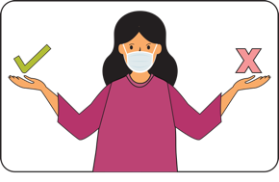
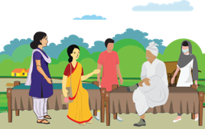
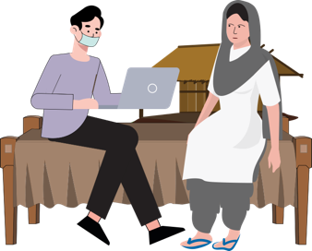
WHAT ARE WE GOING TO LEARN?
1
5
ROLE OF THE CBO staff & about COVID-19
The role that a CBO member plays and what she/he needs to understand about COVID-19
Stigma and discrimination Myths and misconceptions around Coronavirus and many fears that result in stigmatising behaviours at various levels. What can SHGs do for arresting stigma related to COVIOD-19
COVID-19
2
6
Communication and Personal Safety
How to take care of their own personal safety
Prevention : Safe Practices
The information and knowledge that the CSO Staff will give to the community on Handwashing, Cough hygiene, Social distancing
7
Communication needs of urban areas
Safe practices for community and homes
Special needs and urban challenges and how SHGs can contribute
3
COVID-19 SENSITIVE PRACTICES
How does the community support inputs required for managing COVID-19 . The section looks at how SHGs and CBOs can work together to give corrcet information to the community.
4
Health, immunization, nutrition, parenting and psychosocial care are important practices that many vulnerable members may miss out on. What can SHG members do?
3

Slide 3
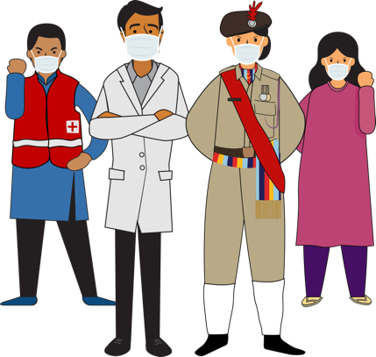
SESSION 1
Communication for Response and Containment Measures

Slide 4
ROLE OF CSO in COVID-19
Under guidance of District / State Coordinators
During Lockdown | Post Lockdown
Risk Communication & Support to FLW (Health) for Essential Services Provide information (a) Preventive and control measures including social distancing during the phases of the COVID outbreak (b) Addressing myths and misconceptions; Support information for Home Quarantine Advise psychosocial support Personal Safety and Precautions | Risk Communication Integration with Regular Services like RI, etc. Continue to provide information on prevention and control measures for safe behaviours at VHND, RI Day, sites Liaise with district / block health officials to obtain lists of LODOR families Contact LODOR families and connect them with regular / outreach RI sessions Communicate key health and nutrition messages

Slide 5
LET US UNDERSTAND ABOUT COVID-19
WHAT HAPPENS WHEN YOU HAVE COVID-19
THE COMMON SYMPTOMS SEEN IN PEOPLE WHO GET INFECTED ARE:
fever
cough and
Difficulty in breathing
COVID-19 is
Coronavirus Disease-2019
It is caused by a virus/germ
Called as Coronavirus
Name: SARS-CoV-2
YOU SHOULD WORRY ABOUT THIS INFECTION IF:
YOU HAVE Travelled TO A PLACE WHERE THE INFECTION iS REPORTED
YOU HAVE BEEN IN CLOSE CONTACT WITH SOMEONE WHO HAS THIS INFECTION
You have lived in the same place as someone who has become positive
THIS germ is small and cannot be seen by the naked eye

Slide 6
TERMS TO KNOW
CORONAVIRUS
COVID-19
EPIDEMIC
PANDEMIC
OUTBREAK
MITIGATION
CONTAINMENT
QUARANTINE
ISOLATION
FOMITES
AEROSOLS
COMMUNITY TRANSMISSION
ASYMPTOMATIC TRANSMISSION
FLATTENING THE CURVE

Slide 7
Current Scenario in India: Necessitates Multilevel Interventions
April 21
18985
COVID-19 is Spreading fast
Exponential Growth
April 15
11933
April 08
5274
March 31
1397
Implications on health and economy and social life
March 15
110
Jan 31
1
March 1
3

Slide 8
Current Scenario in India: Measures to Contain the Infection
LOCKDOWN : All movement except essential services curtailed
PERSONAL SAFETY : Measures of Hand hygiene and Respiratory Hygiene promoted
PHYSICAL DISTANCING : Physical and social distancing measures promoted
CONTACT TRACING: Tracing all those who may have been in contact with a confirmed person.
CLUSTER CONTANMENT: It is a barrier erected around the focus of infection.
DISINFECTING : disinfecting through spraying of sodium hypochlorite solution

Slide 9
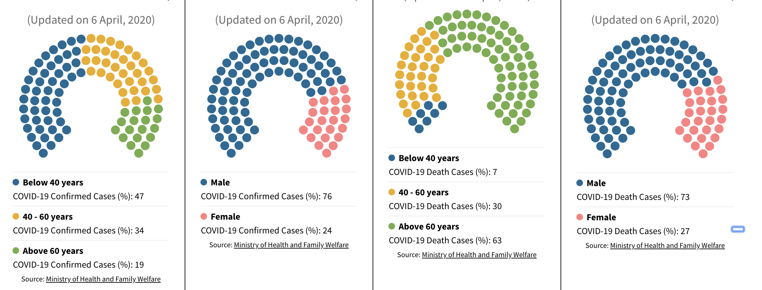
Age profile of COVID-19 Confirmed cases in India
Gender profile of COVID-19 Confirmed cases in India
Age profile of COVID-19 Death cases in India
Gender profile of COVID-19 Death cases in India

Slide 10
Session Summary
SARS-CoV-2 is the virus that causes the disease called as COVID-19
Symptoms of COVID-19 in India are fever and cough and/or shortness of breath
The spread of the disease is exponential making it a very infectious disease
Measures for containment of COVID-19 include Lockdown, Personal Safety Precautions, Contact Tracing and Cluster Containment

Slide 11
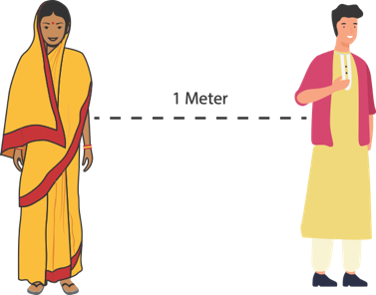
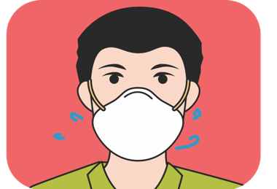
SESSION 2
PREVENTION: SAFE PRACTICES FOR COMMUNITY MEMBERS
HAND
HYGIENE
RESPIRATORY
HYGIENE
SOCIAL
DISTANCING
MANAGEMENT OF FACE COVERS

Slide 12
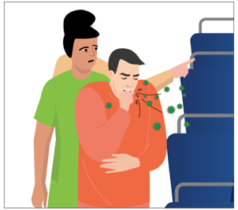
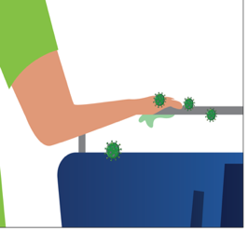
TRANSMISSION
An infected person coughs or sneezes
Then droplets are given out from his mouth or nose
These droplets carry the virus with them
If you are anywhere near this person, the droplets are likely to fall on you and then enter your system through your nose, mouth or eyes.
The cough or cold droplets carrying the virus fall on a surface like bus handles, buttons, mobile, wood, cartons, table, etc.
When you touch that surface, the virus transfers to your hand
When you touch the hand to your mouth or nose, the virus enters your body and makes you sick.

Slide 14
HAND HYGIENE
PREVENTION - WHAT TO DO?
Hand hygiene is a way of cleaning one's hands that substantially reduces potential pathogens (harmful germs) on the hands. Hand hygiene procedures include hand washing with soap and water for at least 40 secs or use of 70% alcohol-based hand rubs
Wash your hands often with soap and water for 20 seconds especially after you have been in a public place, or after blowing your nose, coughing, or sneezing.
Use a hand sanitizer (at least 70% alcohol based) if soap and water not available cover all surfaces of your hands and rub them together until dry. (HANDWASHING VIDEO and SONG)
DO
touch your eyes, nose, and mouth with unwashed hands.
touch surfaces like door knobs and door bells, elevator buttons, handrails, support handles, chair backs, ATM surfaces, mobiles, jeep handles etc
DO NOT

Slide 15
HAND HYGIENE
PREVENTION - WHAT TO DO?
Hand hygiene also extends to ensuring that frequently touched surfaces in the house are disinfected
Cleaning all high touch surfaces like door handles, frames, mobiles etc.
During SHG meetings ensure disinfecting before and after the meeting
These surfaces are to be cleaned with 1% Sodium Hypochlorite solution. (Cleaning aND DISINFECTING VIDEO AND SONG)
DO
MIX 33 gram BLEACHING POWDER IN 1 LITRE OF WATER
OR
MIX 250 ML Sodium hypochlorite (5%) IN 1 LITRE OF WATER
OR
MIX 110 ML Sodium hypochlorite (10%) IN 1 LITRE OF WATER
1% SODIUM
HYPOCHLORITE

Slide 16
PREVENTION: RESPIRATORY HYGIENE
Respiratory Hygiene is a combination of measures taken to stop the spread of germs through respiratory behaviours like coughing or sneezing (SONG AND VIDEO)
DO
DO NOT
DO USE a handkerchief or a tissue to cover your face while coughing or sneezing
DO THROW the used tissue immediately into a closed dustbin
DO COVER your sneeze into your bent upper arm in case you are not carrying a tissue or a kerchief.
DO WASH hands immediately after you have covered your sneeze or cough
DO NOT use other ways of covering your face while coughing or sneezing, like the chunni or the gamcha as these may be used for face covers and if infected can transfer infections
DO NOT spit in the open, always use a spittoon or wash basin for spitting

Slide 17
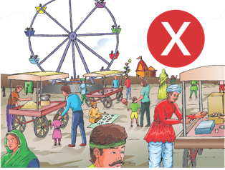
PREVENTION: SOCIAL DISTANCING
SOCIAL DISTANCING : deliberately increasing the physical space between people to avoid spreading illness. Staying at least ONE meter away from other people lessens your chances of catching COVID-19.
Stay at home unless absolutely necessary
Keep a distance of at least one meter between yourself and another person
WHEN THE LOCKDOWN LIFTS AND SHG MEETINGS ARE HELD AGAIN, ENSURE PHYSICAL DISTANCING
IF SHGS ARE DOING ANY COOPERATIVE WORK, Stagger WORK TIMES, MAINTAIN DISTANCE
DO
DO
NOT
DO NOT Hold events at home or attend events where you will have a large gathering
DO NOT go to crowded places like markets, shopping, MELAS, parties
While using public transport try not to touch handles seat backs etc if you can avoid it

Slide 18
Use of Face Covers
1. What is a face cover and why should you use it?
The MoHFW has now issued an advisory on use of face covers. MOHFW recommends that people wear a cloth face covering to cover their nose and mouth in the community setting. This is to protect people around you if you are infected and also to protect you from getting infected.
2. Do I need to practice social distancing if wearing a face cover
Yes. Wearing cloth face coverings is an additional public health measure. MoHFW still recommends social distancing and maintaining at least 1meter away from other people, frequent hand washing with soap and water. A cloth face covering is intended to protect the wearer, as well as prevents the spread of virus from the wearer to others.
3. How to put on a face cover?
Fit snugly but comfortably against the side of the face be secured with ties or ear loops
Include multiple layers of fabric
Allow for breathing without restriction
4. How do I take care of the face covers?
Face covers should be taken off and washed in warm soap and water or 1% bleach solution. Immediately on taking off the face cover, do not keep it lying around but put it for washing
5. What are the precautions in using a face cover?
Do not touch your face when you are wearing a face cover
practice social distancing even when you wear a face cover.
Do not take your face cover on and off many times.
While taking it off, the outer side of the cover should not touch your face. Put it for washing and never re-use face cover without washing

Slide 19
Session Summary
Coronavirus is transmitted by respiratory droplets and fomites
Hand hygiene, Respiratory hygiene and Social distancing are the three personal safety measures
Three layered masks should be used by health care providers. For the common man, a re-usable face cover provides equal protection from getting the infection

Slide 20
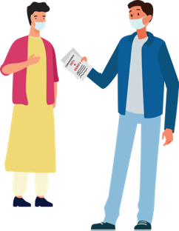
SESSION 3
PREVENTION: SAFE PRACTICES IN THE COMMUNITY & HOME
CREATE
SUPPORTIVE
ENVIRONMENT
TRAVELLING BACK HOME FROM CITY
HOME
QUARANTINE -SELF
HOME CARE

Slide 21
Response and containment– Create a Supportive environment
Identify local influencers
PLAN COMMUNITY SUPPORT
COORDINATE WITH HEALTH DEPT.
Get in touch with your influencers
Explain & discuss the situation and protocols / orders/ notifications to be followed and seek their support in giving key messages.
Identify community and cultural networks and keep them ready with information
Coordinate with the local health dept for planning of immunization services, midday meals , medicines
Share emergency contact details of as directed
Share coordinating details of Child protection committees for addressing issues of trauma and violence in children.
Make a list of LODOR families with high risk children and women in the village
Identify SHG members who can access such families to give them key messages
Identify SHG members who can help in support for the older community members

Slide 22
HOME QUARANTINE: STAY SAFE FOR PROBABLE INFECTED PERSON
RESTRICTED MOVEMENT FOR COVID-19 SUSPECTS
KEEP DISTANCE
AVOID VISITORS IN THE HOUSE
Stay in a well ventilated specific room and away from other people in your home. Restrict movement
If available, use a separate bathroom
If you are infected, you can spread infection to others
SEEK HEALTH CARE AND NOTIFY
AVOID GOING TO PUBLIC AREAS
If you have fever, cough or breathing difficulty and suspecting contact, wear a mask and immediately notify nearest health facility
Avoid using public transport
Do not go to markets, schools or other public areas
WEAR A MASK
Wear a mask correctly when you are around other people
Wear a mask when you are visiting the health facility

Slide 23
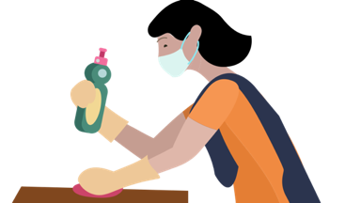
HOME QUARANTINE: CARE GIVER and Family Members
Only one person should take care of the person who is probably infected
All clothes, bedding, utensils of the suspected person should be kept separately
Wash clothes separately in bleaching solution (10 teaspoons of bleach in 1 medium bucket of water) or warm water and soap. Dry clothes in the sun
Clean all places where the infected person may touch with soap and water or bleach solution
Monitor: if the person shows fever or cough or difficulty in breathing, immediately call nearest health facility
All household members to stay away from the member who may be infected.
If interacting, wear a mask
Do not use bedding or clothes or utensils of the person
Wash cloth masks in bleach solution
Do not let small children play with the mask
Do not thrown the masks in open spaces. You may bury them after use.
Wash hands often
Avoid high touch surfaces
Notes:
=

Slide 24
Session Summary
Community support has an important role to play in the containment of the infection
Guidance through local influencers and community support networks can take care of stigma and discrimination as well as ensure access to services for the vulnerable and marginalised population
Home quarantine is an important measure that must be followed for ensuring control of infection.
Quarantine procedures for contact, caregiver and family members must be well understood and followed

Slide 25
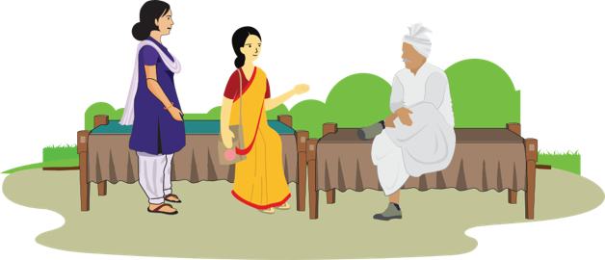
SESSION 4
COVID SENSITIVE PRACTICES: HEALTH, NUTRITION, PARENTING AND PSYCHOSOCIAL CARE
Health & Immunisation
Nutrition
Parenting
Psychosocial Care

Slide 26
Essential Health Services
During lockdown
Advice on maintaining physical distancing and using telemedicine facilities to avail essential services (maternal, new born and child health, prevention and management of communicable diseases, treatment for chronic diseases to avoid complications, and addressing emergencies)
Telephonic information on availability of alternate models for outreach services and use of peripheral facilities (SHCs/ PHCs/UPHCs, including HWCs/ Urban Health Posts) as per designated times.
Post Lockdown
Inform mothers about outreach immunization sessions
Facilitate home visits by ASHAs to include high risk pregnant women, newborn, elderly.
Inform ASHA for any probable case of GBV, ILI/ SARI, malaria, dengue, TB and report to MO
Liaise with beneficiaries and service providers to ensure adherence to all standard protocols for Infection Prevention Control

Slide 27
Health and Immunization: COVID-19 Prevention
Facilitate physical distancing of 1 meter at the facility / outreach session / VHND / RI day
Check if handwashing or sanitizing facilities can be maintained at the immunization center
Facilitate adequate respiratory hygiene by the beneficiaries and their children including using a face cover
Advise and motivate beneficiaries to do handwashing for self and children immediately on reaching home

Slide 28
Take care of your Health : Key Messages to be given
Regularly use the health and nutrition services (such as Routine Immunization, Take Home Ration etc) if being delivered in the current situation.
If pregnant and have fever, cough with breathing difficulties do not delay. Immediately report at your nearest hospital or health facility
While visiting the health facility, wear a mask and wash your hands frequently with soap even after sneezing and coughing; and touching clean surfaces
Follow all Antenatal Care practices for pregnant women
Monitor your symptoms regularly if you have travelled out

Slide 29
Take care of your Nutrition: Key Messages to be given
Continue to breastfeed young children with required respiratory hygiene and precautions for infection prevention
For children’s rapid growth and brain development, initiate complementary feeding from 6 months of age.
Make children’s every bite count by feeding the child a variety of foods such as pulses, milk, milk products, yellow, orange, green vegetables and fruits
Ensure pregnant women get proper nutrition through 3 main meals and 2 snacks
Eat fresh, cooked food including local fruits and vegetable and at least 8 glasses of water daily.
Use the Take Home Ration from the Anganwadi centers for feeding children and pregnant women.

Slide 30
Parenting and Psychosocial Care : Key Messages
BECAUSE
Children can’t go to play and schools are closed. It is normal to feel stressed and overwhelmed
COVID-19 has taken away daily work, home and school routines. This is hard for children, teenagers and for parents
Teenagers and parents may receive stressful messages through social media, including fake news
RECOGNIZING STRESS – COMMON RESPONSES TO STRESS ARE
Difficulty in sleeping
Bedwetting
Pain in the stomach or head
Being anxious, withdrawn, angry, clingy or afraid to be left alone
MANAGING
Recognise and accept the stress in children
Talk to your local support for getting guidance
Talk with other parents
Talk to children and make them feel safe by assuring them that you are there to support them
Ensure proper nutrition for children
Call Child Helpline 1098 for any support for children

Slide 31
Session Summary
Review the services rendered by you / your CSO / CBO in terms of during and post lockdown.
Ensure three key behaviours, physical distancing of 1 meter, respiratory hygiene and handwashing by those availing health services like immunization
Appropriate advice on health and nutrition
Prepare parents to provide psycho-social support to children

Slide 32
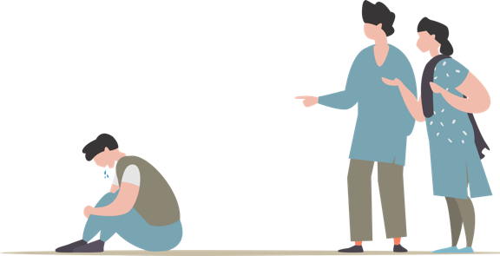
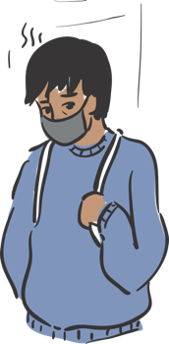
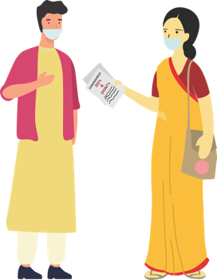
SESSION 5
STIGMA AND DISCRIMINATION
WHAT IS
STIGMA?
WHY IS THERE
STIGMA?
WHAT DOES
STIGMA DO?
WHAT CAN
CSO / CBO DO?

Slide 33
WHAT IS STIGMA?
In any Epidemic, it is common for individuals to feel
stressed and worried because they fear:
Avoiding approaching health facilities due to fear of becoming infected while at the doctors, falling ill and dying
Fear of losing livelihoods, not being able to work during isolation, and of being dismissed from work
Fear of being socially excluded/placed in quarantine because of being associated with the disease
Feeling powerless in protecting loved ones and fear of losing loved ones because of the virus or being separated during quarantine
Stress is caused due to the above fears and being treated as an outcaste or blamed for spreading the disease

Slide 34
WHY IS THERE STIGMA?
The level of stigma associated with COVID-19 is based on three main factors:
COVID-19 is a new disease about which many things are still being discovered.
When something is unknown people are worried which leads to fear
Rumours or fake news give wrong information and spreads the fear.

Slide 35
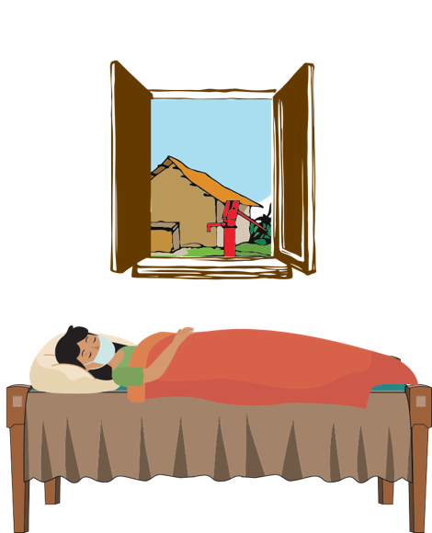
WHAT DOES STIGMA DO?
Discourages them &
may at times prevent
them from adopting
healthy behaviours
Makes people hide
their problems
Keeps people away
from accessing
health services and
seeking help

Slide 36
WHAT CAN CSO Partners / CBOs DO?
Sensitize people and help them to understand that it is a simple infection
and 80% of the cases are mild cases.
Ask people to stay away from watching negative things on the TV and
also fake news
Help in giving hope and positive news to help people handle stress. Encourage the people to amplify positive news through their groups
Publicly, use terms like people who have COVID-19 instead of “COVID-19 cases” or “victims”. Similarly, use terms like people who may have COVID-19 instead of “suspected cases”

Slide 37
Session Summary
Stigma is there because COVID-19 is new and unknown
It results in people hiding their problems, keeping away from health services and preventing them from adopting safe practices
CSO / CBO teams can help people by roping in community networks and influencers to tackle stigma

Slide 38
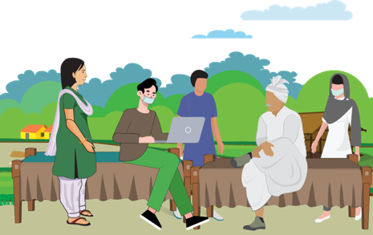
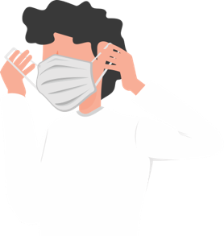
SESSION 6
COMMUNICATION AND PERSONAL SAFETY
WHAT TO
COMMUNICATE
HOW TO
COMMUNICATE?
MASK
MANAGEMENT
PRECAUTIONS

Slide 39
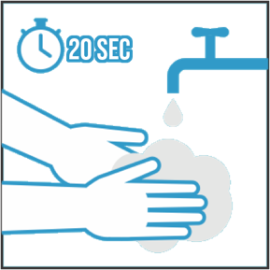
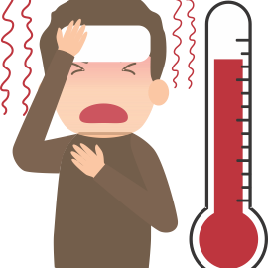
what to communicate & communication platforms
Share mobisodes
Display IEC materials at appropriate places
Use essential services (like garbage collection vans, milk supply, etc.) For miking
Share WhatsApp messages on groups
Use pocket book for giving key messages
Digital Platforms
Mobile Kunji
Ammaji Mobisodes
www.newbornwhocc.org
http://www.unicefiec.org/
https://www.mohfw.gov.in/
HAND and Respiratory HYGIENE
Social Distancing
Home Care & Home Quarantine
Essential services
Health and Nutrition

Slide 40
communication: how?
Always be polite. Anyone can get the infection. Do not discriminate, shout, or use rude language. Support FLWs in reducing stigma
Be aware that suspected and confirmed cases, and any visitors accompanying them, may be stressed or afraid. So, the most important thing you can do is to listen carefully to questions and concerns.
When you meet people, avoid touching or direct physical contact. This is true for passing on infection either way. Maintain distance of more than 1 meter when you interact.
Be very specific with your questions and confirm they have understood you
Do not preach or give news that is not confirmed by your immediate Supervisor, ASHA/ANM
If there are questions and you have the answers, you must share this with the community member. However if you do not have the answer, do not hesitate to say so. A lot is still unknown about COVID-19

Slide 41
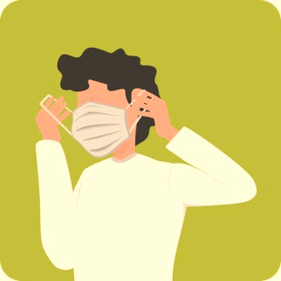
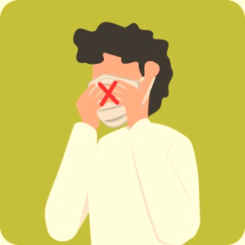
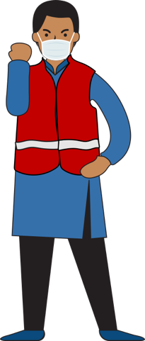
mask management
Use a Mask / Home made Face Cover Correctly:
Unfold pleats, facing down, place over nose, mouth and chin.
Fit nose piece over nose-bridge. tie strings upper string tied - top of head above ears lower string at the back of the neck.
Leave no gaps on either side of the mask, adjust to fit.
Do not pull the mask down or hang from the neck
Avoid touching the mask while in use.
Replace masks with a new clean, dry mask as soon as they become damp/humid, 6 -8 hours
Use a mask if and only when:
You develop fever, cough or difficulty in breathing
You visit a health care facility.
You are caring for an ill person
When contact tracing
Removing and Disposing the Mask / Home made Face Cover
Do not re-use single-use masks
Do not touch other surfaces of the mask while removing.
To remove mask first untie the string below and then the string above and handle the mask using the upper strings. Other surfaces may be potentially contaminated
Remove the mask by using appropriate technique (i.e. do not touch the front but remove the lace from behind)
After removal or whenever you inadvertently touch a used mask, clean hands by washing with soap and water for 20 Secs or using a 70% alcohol-based hand rub
Discard single-use masks after each use and dispose of them immediately upon removal / Wash the home-made Face Cover daily with soap and water

Slide 42
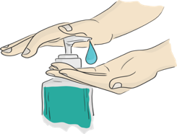
PRECAUTIONs AND SAFETY MEASUREs
When moving around the community
Immediately on reaching home
Maintain distance of at least 1 meter from people when you are communicating
Use a three layered mask to cover your face. Make sure it is properly worn.(while contact tracing)
Avoid touching your face (eyes, nose, mouth) at all times
Wash your hands with soap and water frequently, or use alcohol based hand-rub
Avoid touching or direct physical contact
Carefully remove and dispose off your face mask by soaking in bleach solution and then throwing it in a covered dustbin. (See: MASK MANAGEMENT).
Wash your hands with soap and water for 20 secs or 70% alcohol based hand-sanitiser before you touch anything else.
Wipe down what you have carried like your purse and mobile with home based disinfectant (4 tsps Of household bleach in 4 cups of water)
If you get any symptoms like fever, cough or Difficulty in breathing REPORT TO the nearest Government Facility or District Surveillance Officer immediately.

Slide 43
Session Summary
Key prevention behaviours (distancing, respiratory and hand hygiene), home care and home quarantine, essential services and health and nutrition services are the main contents for communication.
Politeness and lending an ear, are key to communication
Masks when worn are to be handled and disposed-off safely
Precautions in field and on reaching home are essential for own safety

Slide 44
SESSION 7
How to meet special communication needs in urban areas
ACTIVATING
SUPPORT
SAFE
PRACTICES
STIGMA & DISCRIMINATION

Slide 45
ACTIVATING SUPPORT
Community support should involve key stakeholders identified in the area and trained to given safe inputs and support
ADVISE COMMUNITY MEMBERS TO
Volunteer for supporting the Community help-desk set up by local municipality
Support the task of preparing reusable face covers, distributing in the community, ensuring that they are given to those who most require. Face cover management to be taught while distribution
Community representative to ensure that setting up handwashing stations, community cleaning and disinfection drive to be taken up regularly by the Municipal corporation
Give information through local political and religious leaders involvement
Give information out through common essential services like garbage vans, milk supply van etc.
Free distribution of bleach/sodium hypochlorite solution and use of the disinfectant to be planned in the community

Slide 46
ACTIVATING SUPPORT
Remember urban areas are densely populated with limited health staff. You need to develop community support to keep everyone and yourself safe.
Identify the high risk groups in the community and help them to isolate themselves to protect them from getting infected
Be in touch with the government services to organise to get the mid-day meals delivered to the children’s homes.
Get key influencers who can help you with vigilance and tracking people who may possibly be infected and report it for referral.
Community level cadre to be trained to ensure compliance of protocols during lock down period
Community level structure to be identified to transform into quarantine facilities

Slide 47
PRACTICING SAFE BEHAVIOURS
Remember many daily wage / unorganized sector workers with severe economic hardship would go to work despite restrictions increasing their vulnerability
Reach out to specific group of people such as labourers, housemaids, shelter home migrants and daily wage workers and advise them to follow:
Frequent handwashing with soap and water for 20 seconds especially after coming from outside, before eating food and after going to toilet.
Change clothes and if possible wash oneself using soap after coming from outside. Avoid touching eyes, nose and mouth.
Avoid spitting in open places and use only a wash basin or spittoon
Maintain a distance of minimum 1 meter from others
Contact community help-desk/ health facility if they develop fever, cough or difficulty in breathing or need any information

Slide 48
Stigma and Discrimination
Remember urban areas are densely populated with limited health staff. You need to develop community support to keep everyone and yourself safe.
Resident Welfare Associations
Many of the societies have stopped maids and other helpers from entering. While this is correct as this will keep people at home, the way of managing this distancing is stigmatizing
Words like “They will bring this disease to us” “The disease will spread because of them” etc are stigmatizing
Work with the local influencers and key decision makers of the area to sensitize people
Use the mass media clips to sensitize
Use government orders to show why housing societies should not discriminate against the working class like car cleaners, maids etc.

Slide 49
Session Summary
Activating support in urban communities is important. Supporting partners in urban areas could be
RWAs
Identified local influencers
Community based local groups / organisations
Youth groups
NSS volunteers
Indian Red Cross volunteers
NYKS-National Youth Volunteers
NCC
Bharat Scouts and Guides

